Slide 1
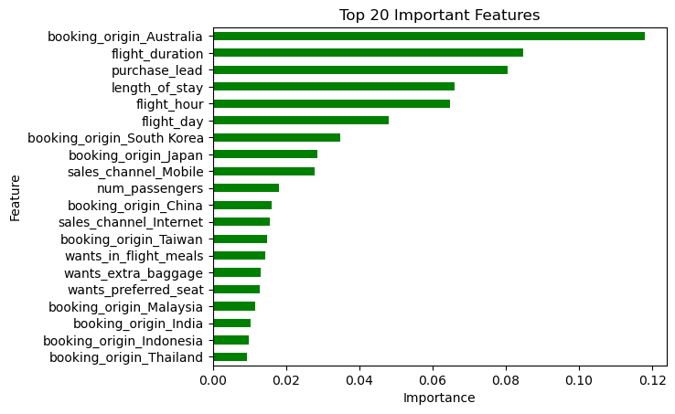
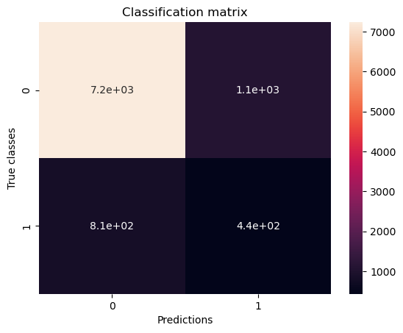
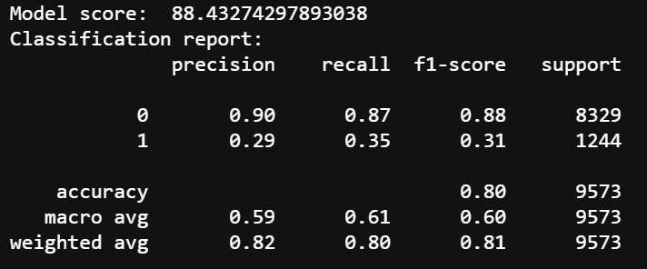
After data cleaning, engineering and augmentation using SMOTE, we trained and evaluated a Random Forest Classifier using cross-validation, and then we got the most 20 important features.

